Slide 1
DATABASE SOURCE CONTROL Intro to Advanced
MARCH 27, 2023
Notes:
Aly

Slide 2
Workshop Initial Setup & Pre-Reqs
Intro – Ryan & Hylaine
Intro to DB Source Control
Workshop
Liquibase Overview
Workshop Scenario
Retro and Questions
Notes:
Aly

Slide 3
Workshop Initial Setup
Install the necessary tools
This project uses SQL Server as the database engine of choice, so install Azure Data Studio: https://bit.ly/3TY2TC1
Ensure you also have Docker Desktop installed, updated, and running as we’ll use it to run a copy of SQL Server and Liquibase
Ensure you have a version of the JRE installed and added to PATH. We suggest OpenJDK.
Pull down the Repository
Repository is stored on Github: https://github.com/hylaine/devopsdays-demo.git
Recommend cloning to C:/Projects or a linux equivalent
Spin up the DB Docker Container
Important! Ensure port 1433 is free. For those with local instances of SQL Server, stop these services and processes.
From the repository’s root directory, execute docker-compose up which will spin up a SQL Server container and provision a target database. Then….. wait
Verify DB Connectivity
Credentials to access the Database are within the markdown and docker-compose files
Server: localhost
Database: devopdaysraleigh
User: SA
Password: DevOpsDaysP4ssword!
Verify that the provided credentials give you sufficient DDL permissions (Create tables/views/etc.)
Notes:
* This workshop works on around 75% of windows machines, but has some latest-and-greatest issues

Slide 4

Ryan McElroy
Vice President of Technology
Working in consulting & moved to Charlotte since 2013
Been with Hylaine since 2017
Working in DevOps for a variety of solutions
Notes:
Won’t spend too long on this slide but it has pretty much everything important. My wife is awesome, I love dogs and Halloween. I also have 2 real human children
I’m employee 2 at Hylaine, and I consider myself a keyboard first architect. My day to day responsibilities still include coding sometimes which I love and hate at the same time.

Slide 5















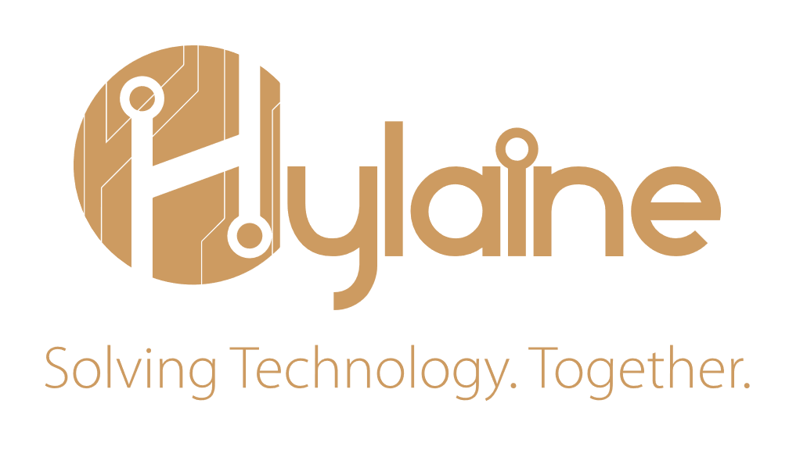
WHO WE ARE
Taking the high road
hylton
We are a culture company who exists to solve problems through technology
=
maclaine
OUR APPROACH
TECHNOLOGY, METHODOLOGY, AND TOOL AGNOSTIC
NON-BILLABLE WHOLE FIRM APPROACH
VALUE BASED FINANCIAL MODEL
TRANSPARENT
RESULTS
FOCUSED
UPBEAT
SOLICIT
FEEDBACK
THANKFUL
TAILORED SOLUTIONS
OUR TEAM
100% US-BASED WORKFORCE
CONSULTANTS AVERAGE 13 YEARS OF EXPERIENCE IN DIVERSE INDUSTRIES
NORTH CAROLINA
CHARLOTTE | 2017
RALEIGH | 2020
TEXAS
DALLAS - FORT WORTH
2022
GEORGIA
ATLANTA
2021
NATIONWIDE
SERVICES
FULLY VETTED FULL TIME EMPLOYEES
INDUSTRY LOW ATTRITION RATE
Notes:
I work for Hylaine, a tech agnostic enterprise consulting firm with a presence here in Raleigh. We’ve been here 3 years now and loved it.

Slide 6
INTRO TO DB SC
Notes:
This talk is intro to advanced, so we’ll start small.
Write down some folks who want to discuss afterwards.

Slide 7
WHY SHOULD DEVS ❤️ DB SC?
Fast onboarding of new team members
Isolation for local development and no waiting on shared infrastructure
Completes the DevOps story for transactional applications
A “Source of Truth” for what the database actually looks like, reducing drift
Greatly increases deployment safety and predictability
Allows application changes to be totally atomic

Slide 8

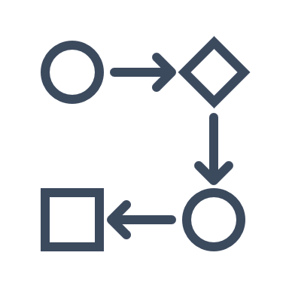

Types of DB Source Control
State Based Source Control
Script Based Source Control
…stores the desired end state of the entire schema in the code repository
…stores the migration scripts in a repository that executes each script in a deterministic order

Slide 9
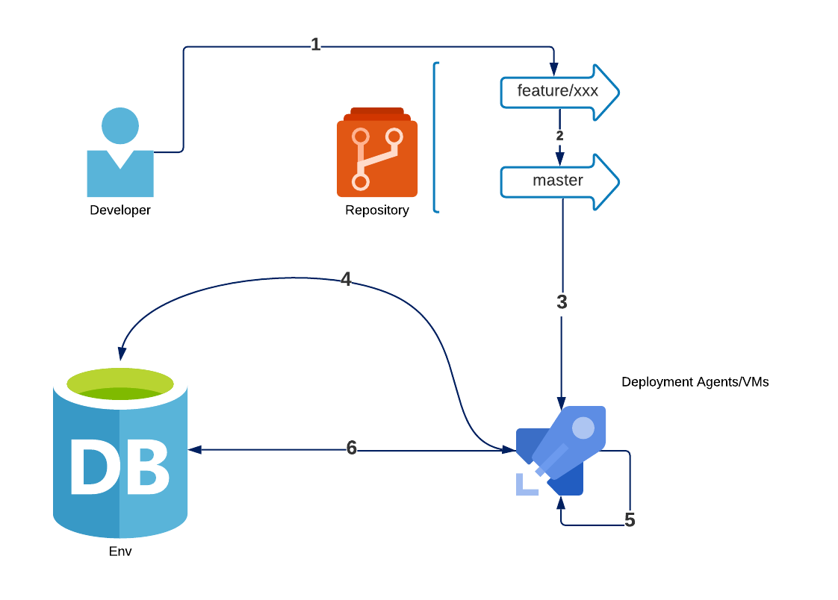
State Based Source Control
A developer changes state definitions
They create a pull request to merge into a deployment branch
An agent retrieves the definition from the repository
It contacts a target DB to acquire its current state
It compares it with the definition state, and creates a dynamic script
It executes the dynamic script (sometimes with additional pre or post deployment scripts).

Slide 10
State Based – Pros and Cons
Pros | Cons
Few/No scripts must be created As database “drifts” across environments, state changes are still propagated Enforces conformance across all environments The definition of the database shows clear changes and responsibility in source control No dependencies on ordering and convention | Can cause destructive changes Generally, takes longer to deploy Does not work as well with huge sets of existing data Requires the defining of indices etc. to be the same across all environments May not exist for all database engines Can be expensive for top-tier tooling

Slide 11
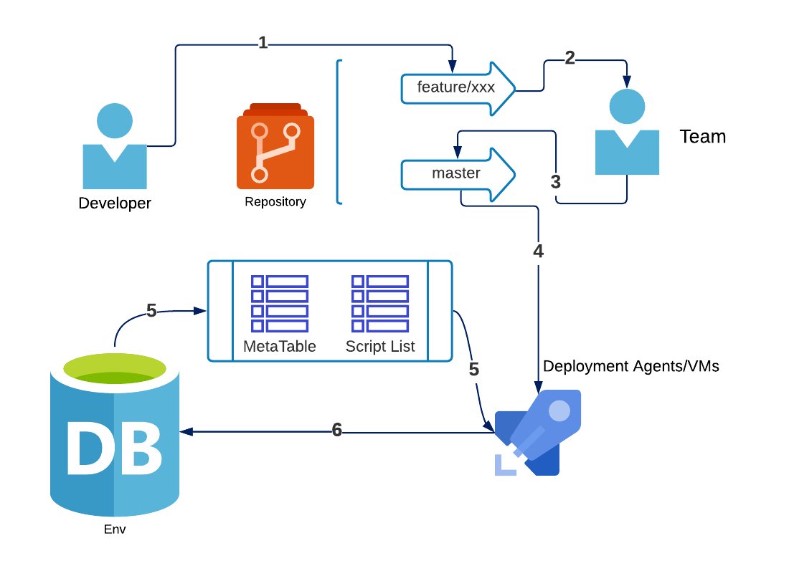
Script-Based Source Control
A developer writes a script to change the database
They create a pull request to add into a deployment branch
Coordinate script ordering with other devs
An agent retrieves all scripts from the repository
It contacts a target DB and checks a “meta table” to see which scripts have not been executed
It executes the scripts that have not been executed

Slide 12
Script Based – Pros and Cons
Pros | Cons
Allows ultimate control of Database changes Can include data migration steps along with schema changes Generally, fast execution Destructive behavior must be intended Affordable or Free – DIY solutions are not only possible, but simple to build | Scripts must be very carefully crafted for idempotence May require the creation of “rollback” scripts as well Allows environment drift to remain unchecked, causing undefined behavior or migrations to break in different environments Requires use of convention and coordination across the team Requires meta-tables or other control structure

Slide 13
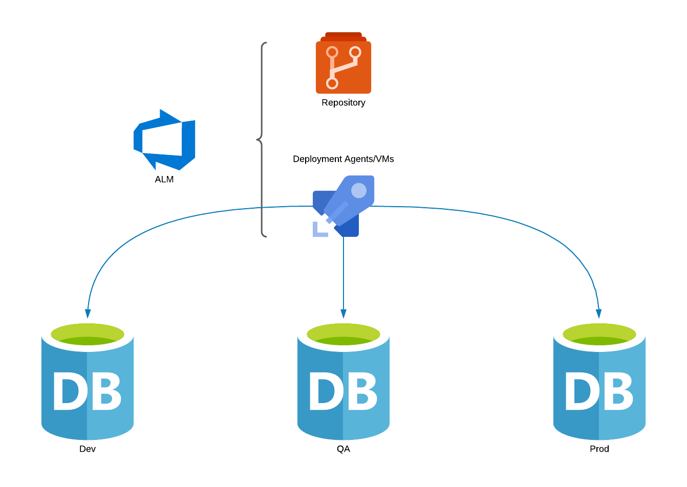
Continuous Integration & Deployment
Why & How | Challenges
Quickly sharing changes to any code is highly valuable Increases potential delivery velocity Ensuring that testers are using the “latest and greatest” by default Automation solves more problems than it causes | Validation on Integration Robust Rollback Deployment Cadence Connection with other code Data Differences

Slide 14

What is Liquibase?
State Based Source Control
Script Based Source Control
Stores the desired endstate of the schema in the code repository via changelog
Allows the specification of state in a changeset, as opposed to an engine-specific script
Uses changeset ordering and a meta-table to control execution
Allows the specification of changesets in engine-specific scripts

Slide 15
WORKSHOP

Slide 16
Workshop Initial Setup
Install the necessary tools
This project uses SQL Server as the database engine of choice, so install Azure Data Studio: https://bit.ly/3TY2TC1
Ensure you also have Docker Desktop installed, updated, and running as we’ll use it to run a copy of SQL Server and Liquibase
Ensure you have a version of the JRE installed and added to PATH. We suggest OpenJDK.
Pull down the Repository
Repository is stored on Github: https://github.com/hylaine/devopsdays-demo.git
Recommend cloning to C:/Projects or a linux equivalent
Spin up the DB Docker Container
Important! Ensure port 1433 is free. For those with local instances of SQL Server, stop these services and processes.
From the repository’s root directory, execute docker-compose up which will spin up a SQL Server container and provision a target database. Then….. wait
Verify DB Connectivity
Credentials to access the Database are within the markdown and docker-compose files
Server: localhost
Database: devopdaysraleigh
User: SA
Password: DevOpsDaysP4ssword!
Verify that the provided credentials give you sufficient DDL permissions (Create tables/views/etc.)
Notes:
* This workshop works on around 75% of windows machines, but has some latest-and-greatest issues

Slide 17
Known Issues and Gotchas
Upon compose, “Co-Initialize Security Failure”
This is a known bug with certain versions of Windows, WSL, and Docker https://github.com/microsoft/mssql-docker/issues/804
The most common solution is to downgrade to WSL1.03
$Package = Get-AppxPackage MicrosoftCorporationII.WindowsSubsystemforLinux -AllUsers
Remove-AppxPackage $Package -AllUsers
Add-AppxPackage .\Microsoft.WSL_1.0.3.0_x64_ARM64.msixbundle
M1 Macbooks and Architecture
Manually specify the architecture in the docker-compose
Ensure that you’ve enabled buildkit in advanced docker options if you’re using an older version
Ensure “Use Rosetta for x86/amd64 emulation on Apple Silicon” is checked
The DevOpsDays DB wasn’t created
Different machines require different spin up times for docker images and SQL server
If you can connect to the default DB (master) then you can manually run instantiate.sql

Slide 18
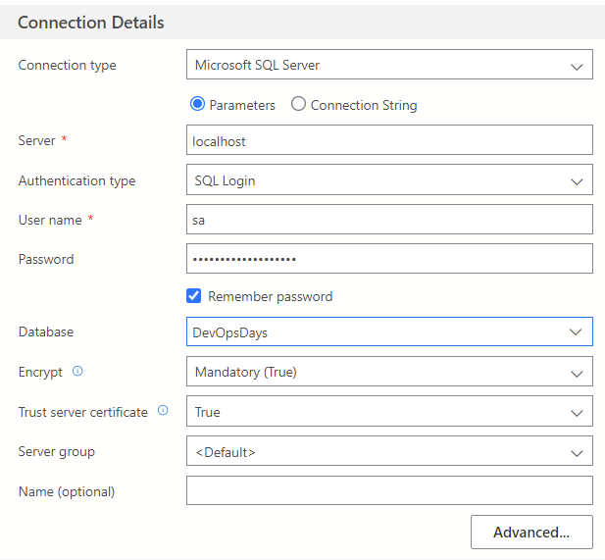
Connection

Slide 19
Workshop Scenario – Previous Context
For the purposes of a short workshop, we want to skip initial setup. This would involve:
Developing V1.0 of a database through DDL scripts
Creating V1.0 Liquibase changelog
(Fancy) Creating a dockerfile that instantiates the DB
Creating a CI Pipeline to validate deployments
Creating a CD Pipeline to automatically push deployments

Slide 20
LIQUIBASE CLI – COMMAND ANATOMY
liquibase <global arguments> <command> <command arguments>
liquibase --changeLogFile=/usr/src/app/devopsdayschangelog.json
--url=jdbc:sqlserver://localhost:1433 --username=sa --password=DevOpsDaysP4ssword!
update > /liquibase-update.log
CORE PARAMETERS
DATABASE CONNECTION
OUTPUT AND EDGECASES
Reference to the CLI tool entry point, differs when added to PATH or executed through a Docker Container
Reference to the changelog file being used that stores state
--defaultsFile should be used for common and repeatable arguments
Uses connection string patterns you’re familiar with
Engine-specific cases and examples available on Liquibase docs
Dockerized DBs will require special parameters compared to live DBs (EX: SSL, MARS)
Logging of to-be executed SQL and other information can be stored on release
Other options include performance monitoring, schema targets for meta-objects, and DB driver specifications
Each DB engine supports and interprets CLI parameters a different way
Notes:
Presenters: Toney/Dan/Krishna

Slide 21
Workshop Scenario - Docker
1. Apply the Liquibase V1.0 Changeset to your localized DB container
Use the command “insert command here”
2. Apply a schema change through Azure Data Studio
Add a table, column, rename a constraint
3. Create a V1.1 changeset
Use the command “insert command here”
4. Push to Github and create a Pull Request
From there, we’ll see the validation flow

Slide 22
Workshop Scenario - Archive CLI
1. Apply the Liquibase V1.0 Changelog to your localized DB container
For Linux or PS: ./Liquibase/liquibase update --defaultsFile="liquibase.properties" --log-file=logs/liquibase-update.log
For Windows CMD: Liquibase\liquibase update --defaultsFile="liquibase.properties" --log-file=logs/liquibase-update.log
2. Create a V2 changelog in a new branch & add to changelog folder
well-formed-changeset.json and ill-formed-changeset.json examples are provided.
You can also create your own custom changelog, if desired, to experiment.
Be sure to use a naming convention! I.E. devopsdayschangelog-2.json
3. Push to Github and create a Pull Request
git add . -> git commit –m “demo” -> git push –u origin my-branch-name
Create the PR to merge into master and watch the validation flow in the “Actions” tab of the GitHub repository

Slide 23



WHAT’S NEXT?
DATA INSERTION & SMOKE
SERVERLESS & LOAD
ROLLBACK & COMPLEX DEPLOYMENTS
Include data insertion as part of a deployment. Separate “Core” from “Demo” data.
Exercise select statements directly on the database OR combine with a robust application pipeline to have smoke exercise the whole stack
Use the ability to dynamically deploy a database to update and stress a prod-like serverless DB
Requires additional pipeline tasks to “Wake Up” instances
Automate rollback on test failure
Include data migration scripts to be executed before or after changesets
Notes:
Presenters: Toney/Dan/Krishna

Slide 24
Ryan McElroy
rmcelroy@hylaine.com
Chase Cupp
ccupp@hylaine.com

